Slide 1
Cross-development software laboratory
Máster Universitario en Ingeniería Informática
Juan Zamorano jzamora@datsi.fi.upm.es

Slide 2
Laboratory assignments
Installation of a native programming environment.
Installation of the cross-platform programming tools.
Real-time On-board data handling (OBDH) program, including temporal analysis
OBDH with Attitude Control System (ACS) and Processor In the Loop (PIL) validation.
Laboratory

Slide 3
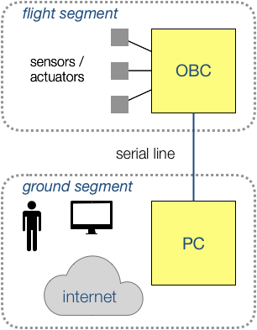
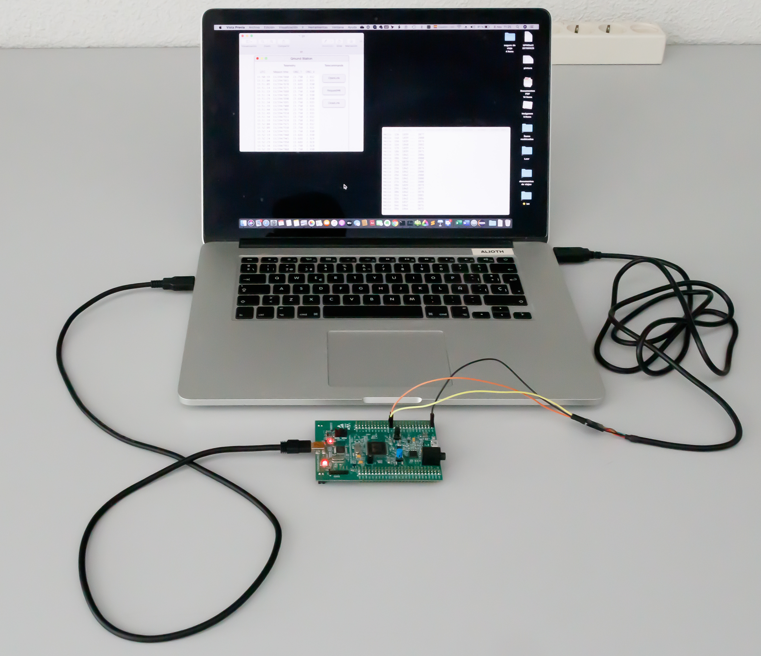
Laboratory kit

Slide 4
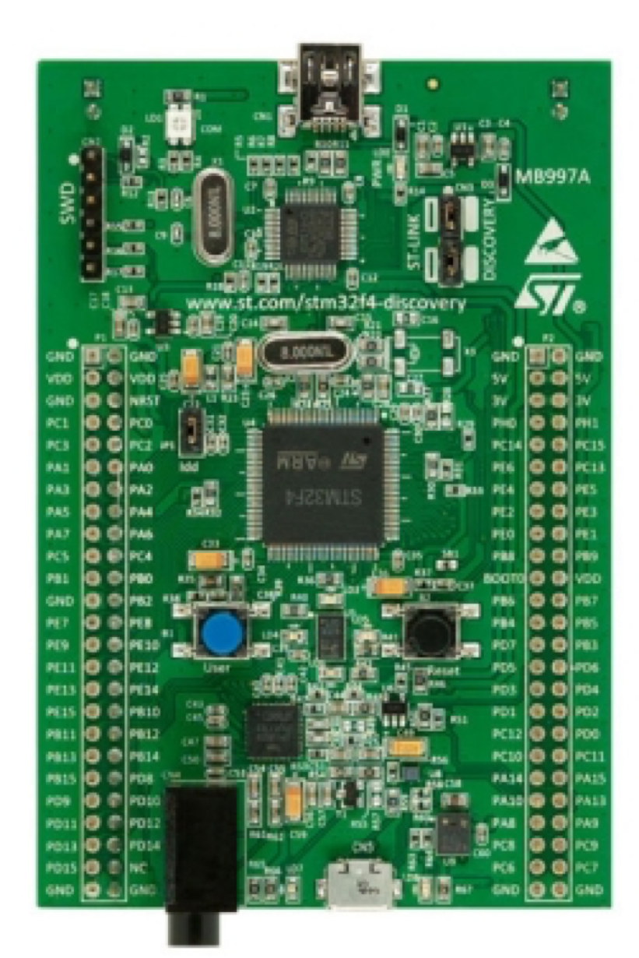
Computer board
USB ST-LINK mini-B connector
PB6 & PB7 pins
GND pin
USB OTG micro-AB connector

Slide 5
1. Install the native compiler
Windows:
Download and run
gnat-2021-20210519-x86_64-windows64-bin.exe
Run the GPS application
Create a new project and enter the source code for hello.adb
Build and run the executable
MacOS and Linux
See laboratory guide
Laboratory

Slide 6
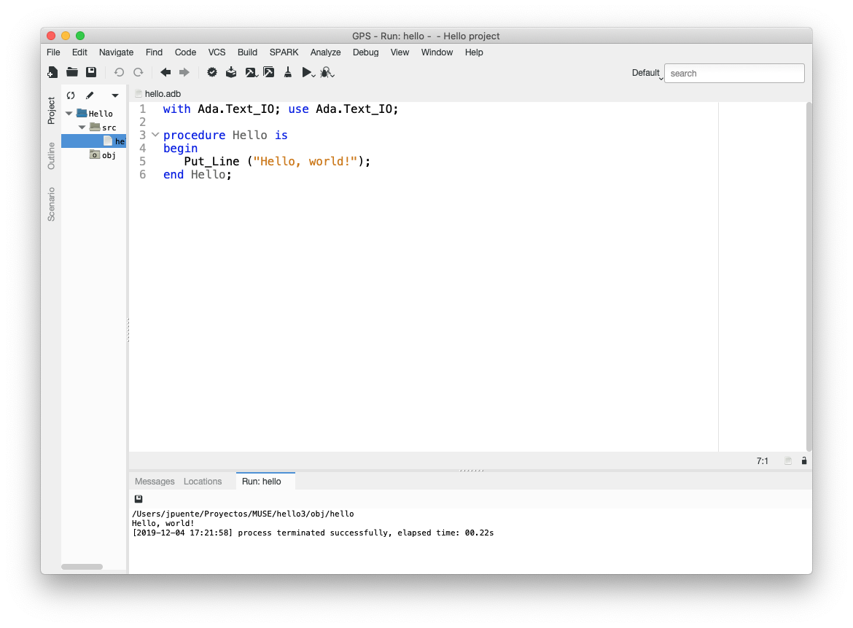
Sample screenshot

Slide 7
2a. Install cross compiler for STM32F4
Windows:
Download and execute the cross-compiler
gnat-2021-20210519-arm-elf-windows64-bin.exe
Download and execute the ST-LINK driver
follow the instructions in readme.txt
Start the GPS application
Create a new project
File > New Project > STM324F compatible > LED demo project template
Set Project > Properties > Embedded > Connection tool to st-util
Build and run the executable
Connect the board to the host computer and flash the executable to the board
Laboratory

Slide 8
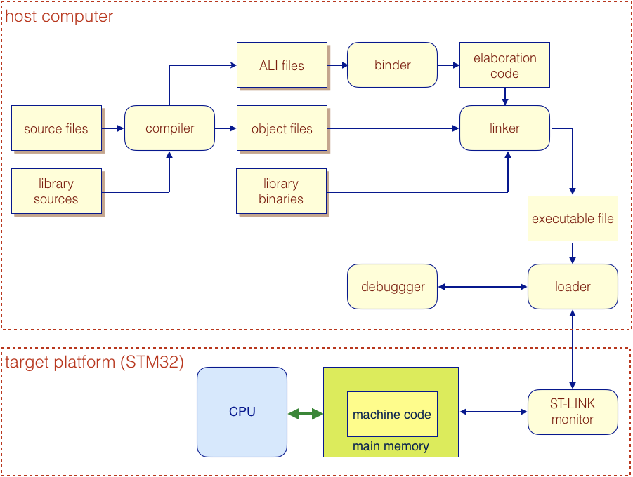
Cross-compilation tools

Slide 9
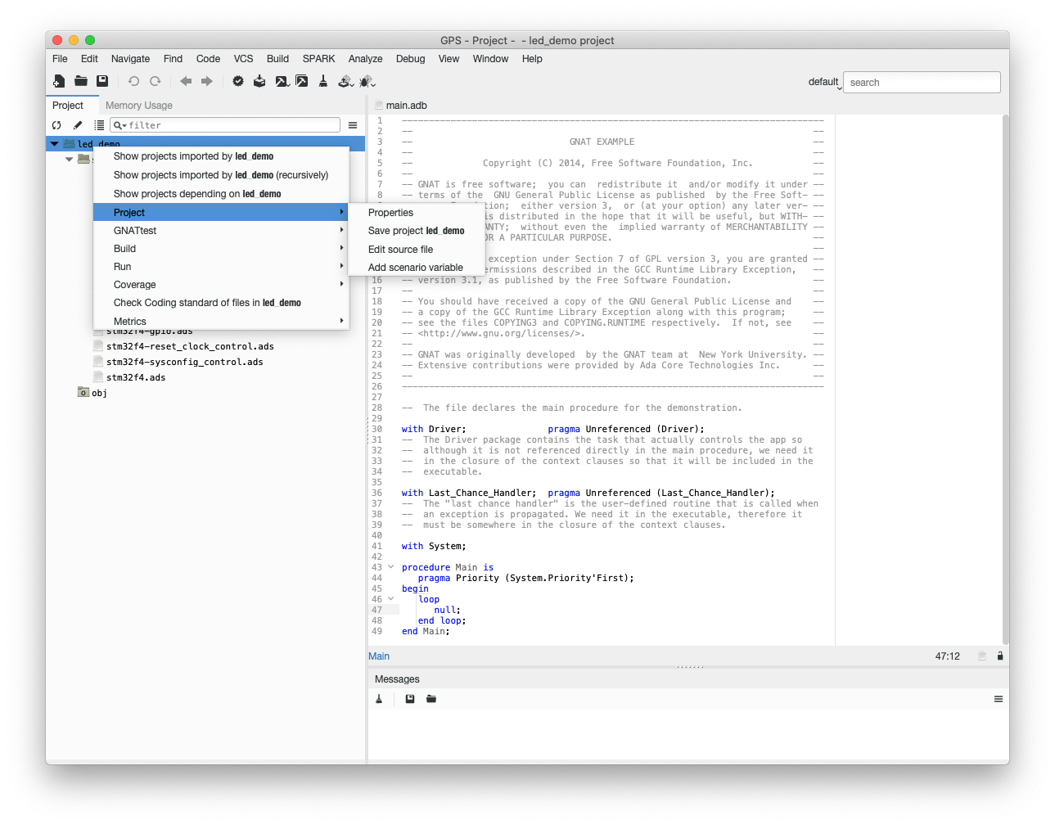
Sample screenshot

Slide 10
2b. Install the Ada Drivers Library and assignment sources
Ada Drivers Library:
Download zip file from
https://github.com/AdaCore/Ada_Drivers_Library
Unzip the archive and move the resulting folder to your laboratory folder
Rename the folder to Ada_Drivers_Library
Open project
…/Ada_Drivers_Library/examples/STMF4_DISCO/blinky_f4disco.gpr.
Build the executable and flash it to the board
Assignment sources:
Download zip file from moodle or
https://github.com/STR-UPM/OBDH_LABS
Unzip the archive and move the resulting folder to your laboratory folder
Laboratory

Slide 11
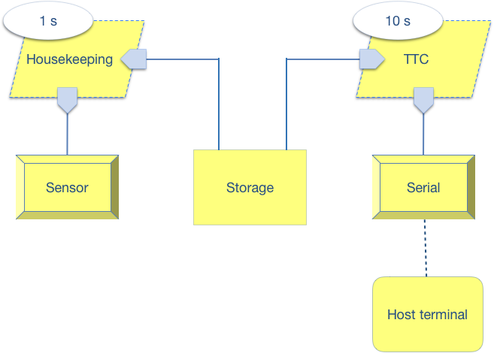
3. Real-time OBDH software architecture
AADL : Architecture Analysis & Design Language
AADL components implemented as Ada packages
main procedure: OBDH
additional packages for data definitions & others as necessary
period
data access
task
device
Laboratory

Slide 12
OBDH tasking system
Two concurrent tasks:
Housekeeping
read a sensor (OBC_T)
use the Ada Drivers Library (ADL) to read the sensor
STM32.Device
STM32.ADC
TTC
display the sensor value
Use a serial interface connected to the host PC
simulate a radio link between flight and ground systems
A protected object for inter-task communication
Storage
the housekeeping task puts the sensor value in the storage
the TTC task gets the value from the storage
Laboratory

Slide 13
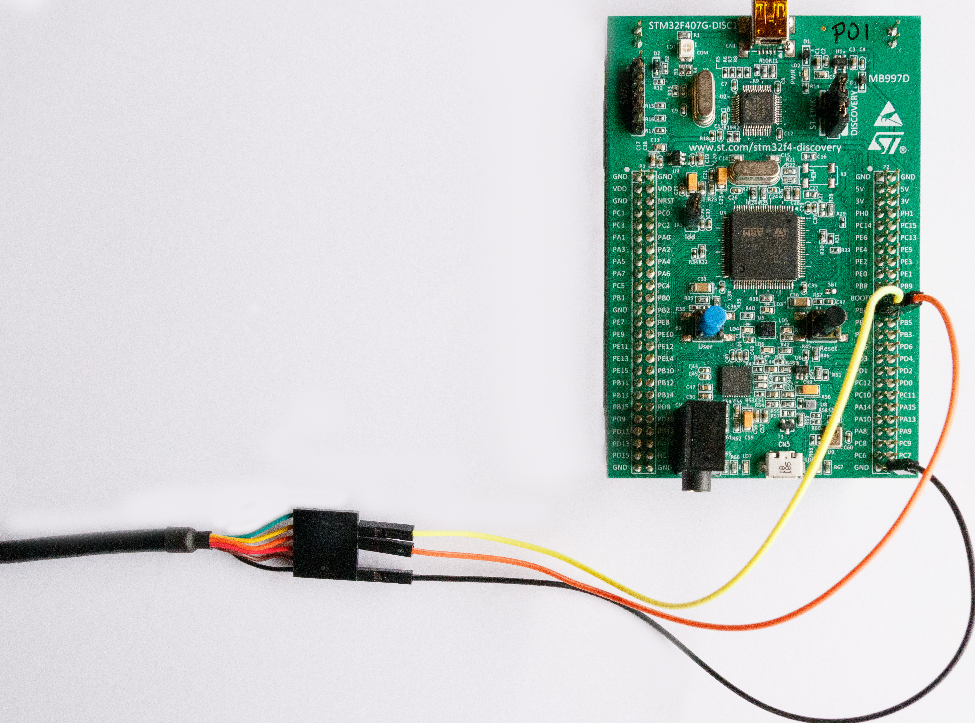
Hardware
Connector pin | Board pin
1 (black) | GND
4 (orange) | PB7
5 (yellow) | PB6

Slide 14
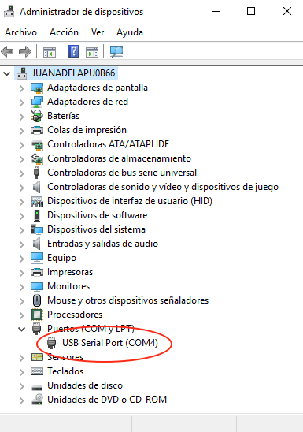
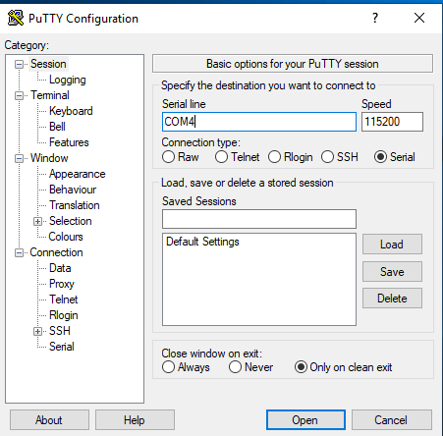
Host terminal
(Windows — for other platforms see manual)
Download and install https://www.putty.org
Find the COM port in device manager (e.g. COM4)
Open PutTTY and configure as serial connection,115200 bps, 8N1
Laboratory

Slide 15
Real-time requirements
Task | Period | Deadline | Priority
Housekeeping | 1,0 | 1,0 | 20
TTC | 10,0 | 2,0 | 10
Storage Buffer | — | — | 20
package Housekeeping is
Period : Time_Span := Milliseconds (1000); -- 1s
HK_Priority : constant System.Priority := 20;
...
private
Start_Delay : Time_Span := Milliseconds (1000); -- 1s
task Housekeeping_Task
with Priority => HK_Priority;
end Housekeeping;

Slide 16
Implementation
task body Housekeeping_Task is
Data : State;
Next_Time : Time := Clock + Start_Delay;
begin
loop
delay until Next_Time;
...
Next_Time := Next_Time + Period;
end loop;
end Housekeeping_Task;

Slide 17
Timestamps
package Housekeeping_Data is
...
type Mission_Time is new Uint64;
-- Seconds since system startup
type State is
record
Data : Analog_Data;
Timestamp : Mission_Time;
end record;
end Housekeeping_Data;

Slide 18
Housekeeping
procedure Get (S : out State) is
OBC_T : Analog_Data;
SC : Seconds_Count;
TS : Time_Span;
begin
Sensor.Get (OBC_T);
Split (Clock, SC, TS);
S.Data := OBC_T;
S.Timestamp := Mission_Time (SC);
end Get;

Slide 19
Storage
package Storage is
procedure Put (Data : State);
procedure Get (Data : out State);
...
-- Real-time attributes
ST_Priority : constant System.Priority := 20;
private
protected Buffer
with Priority => ST_Priority
is ...
...
end Storage;

Slide 20
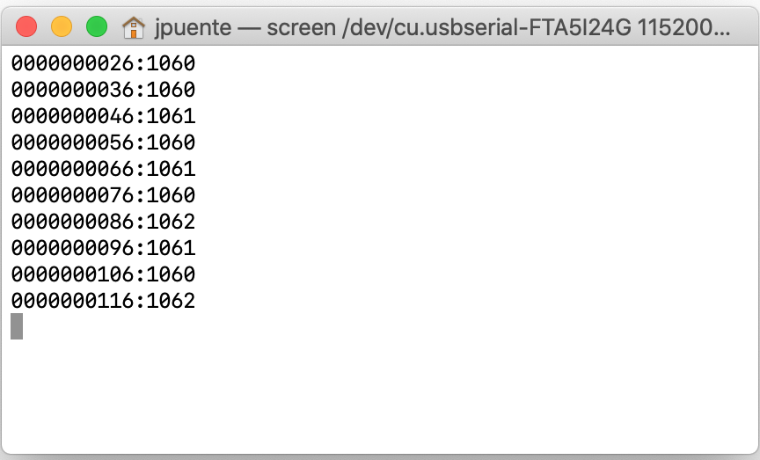
Laboratory work
Open project .../LAB6/RT_housekeeping/real_time_housekeeping.gpr
Build the executable and flash to board
Make sure the TTY cable is connected
Telemetry messages appear on the ground terminal

Slide 21
Real-time analysis
Task structure
Real-time attributes
1 s
10 s
Housekeeping
TTC
Storage
Task | T | C | B | D | R | P | CPut | CGet
HK | 1,0 |  |  | 1,0 |  | 20
TTC | 10,0 |  |  | 2,0 |  | 10
 |  |  |  |  |  | CP | 20 | 20
Laboratory

Slide 22
Average-Case Execution Time (ACET) measurement
A simple dynamic measurement technique will be used in the laboratory
Execute task bodies a number of times and measure times with the board real-time clock
e.g. for HK task
the estimated ACET in seconds is C/N
T1 := Clock;
for I in 1..N loop
Get(Data);
Storage.Put (Data);
T := T + Period;
end loop;
T2 := Clock;
C := T2 - T1;
Laboratory

Slide 23
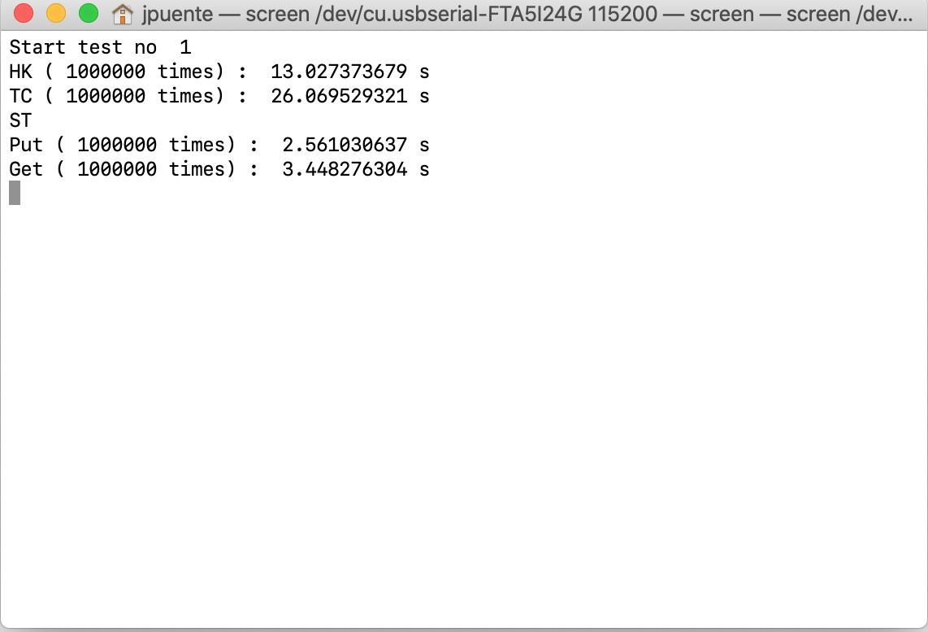
Laboratory work
Open project .../LAB6/RT_housekeeping/wcet_meter.gpr
Study the source code
Build the executable and flash to board
Make sure the TTY cable is connected
Analysis results appear on the ground terminal

Slide 24
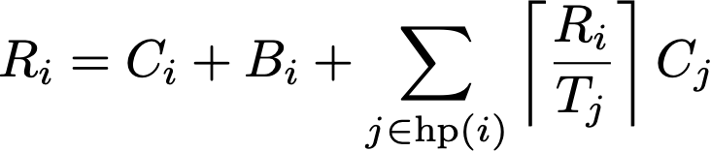
Real-time analysis with measured values
Task | T | C | B | D | R | P | CPut | CGet
HK | 1,0 | 13·10⁻⁶ | 4·10⁻⁶ | 1,0 |  | 20 | 3·10⁻⁶ | —
TTC | 10,0 | 26·10⁻⁶ | — | 2,0 |  | 10 | — | 4·10⁻⁶
 |  |  |  |  |  | CP | 20 | 20
Task | T | C | B | D | R | P | CPut | CGet
HK | 1,0 | 13·10⁻⁶ | 4·10⁻⁶ | 1,0 | 17·10⁻⁶ | 20 | 3·10⁻⁶ | —
TTC | 10,0 | 26·10⁻⁶ | — | 2,0 | 39·10⁻⁶ | 10 | — | 4·10⁻⁶
 |  |  |  |  |  | CP | 20 | 20
All deadlines are guaranteed
Laboratory

Slide 25
Laboratory work
Open project .../LAB6/RT_housekeeping/wcet_meter.gpr
Study the source code
Build the executable and flash to board
Make sure the TTY cable is connected
Analysis results appear on the ground terminal

Slide 26
Additional tasks
Include the conversion to Celsius in the Display.Put procedure.
Temperature function of HK_data-converter that can be found in utilities directory can be used.
OBC_T : MCU internal temperature sensor
connected to ADC1_IN16 input
range -40 .. +125 ºC
14-bit reading VSENSE: 0 .. 4095
Temperature (in °C) = {(VSENSE – V25) / Avg_Slope} + 25
Symbol | Parameter | Min | Typ | Max | Unit
_{TL}(1) | V_{SENSE} linearity with temperature | - | ±1 | ±2 | °C
Avg_Slope⁽¹⁾ | Average slope | - | 2.5 |  | mV/°C
V₂₅(1) | Voltage at 25 °C | - | 0.76 |  | V
^{t}START⁽²⁾ | Startup time | - | 6 | 10 | μs
^{T}S_temp⁽²⁾ | ADC sampling time when reading the temperature (1 °C accuracy) | 10 | - | - | μs
Laboratory

Slide 27
4. OBDH with ACS software architecture
tasks
period
period
2 s
ACS
Serial
protected object
Host terminal

Slide 28
OBDH with ACS tasking system
Include three tasks:
Housekeeping
read a sensor (OBC_T)
TTC
display the sensor value using semi-hosting
ACS
control the attitude of the satellite
Host computer runs Simulink model of the environment
Host and target interchange sensor readings and actuator outputs by serial line
Laboratory

Slide 29
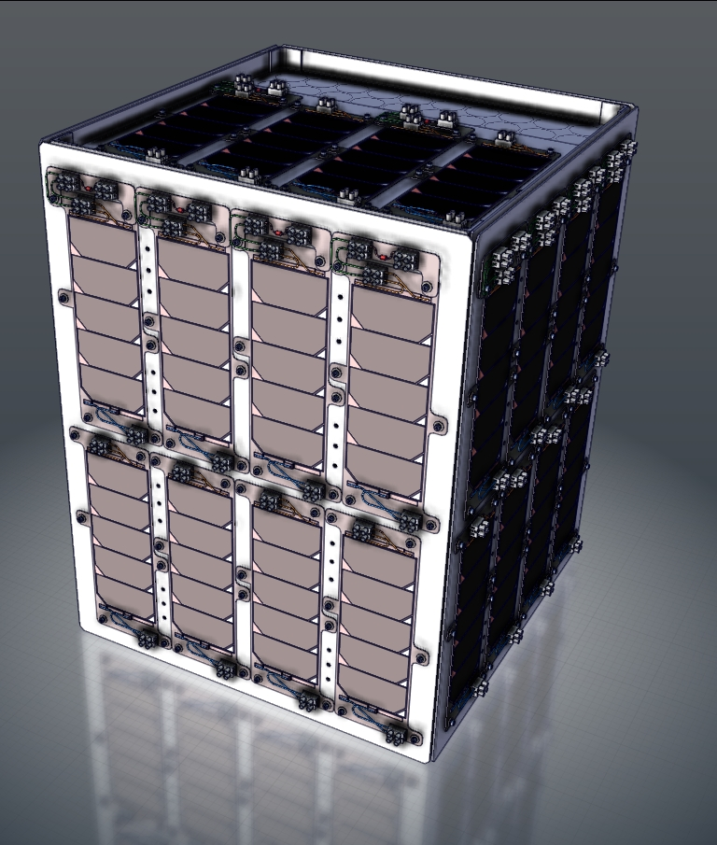
UPMSat-2
Experimental micro-satellite
0.50 × 0.50 × 0.60 m, 50 kg
sun-synchronous orbit
700 km, 98 min period
powered by solar panels
VHF radio dual link 400 MHz
Dipole antenna on top face
must be visible from Earth at all times

Slide 30
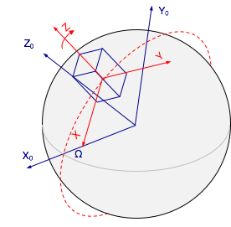
Attitude control frames
Body reference frame XYZ
antenna on Z axis
Orbital reference frame X0Y0Z0
inertial for short intervals
Attitude reference
align Z with Z0
slow rotation around Z

Slide 31
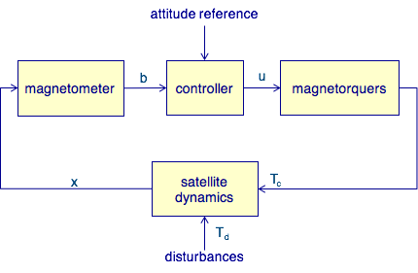
Magnetic attitude control

Slide 32
Magnetometers / magnetorquers
Magnetometers provide a measurement of the Earth's magnetic field components in the body frame
b : magnetic field vector
Magnetorquers generate a control torque normal to the orbit
m: magnetic moment vector
proportional to the current in each magnetorquer coil
mi = AN·Ii
Laboratory

Slide 33
Validation steps: Model-in-the-loop
Preliminary validation of control algorithm
Use a model of the ACS, together with models of the space environment and the spacecraft dynamics, to assess the validity of the control law and the design parameters.
Usually carried out by a control engineer using a simulation tool.
Simulink is commonly used for ACS development.
Notes:
PIL TRL 4

Slide 34
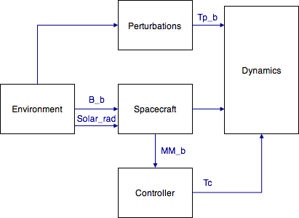
ACS MIL (Model In the Loop) validation
Laboratory

Slide 35
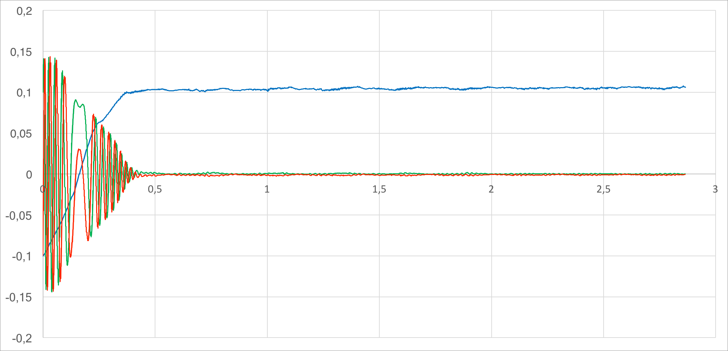
Angular velocity stabilization

Slide 36
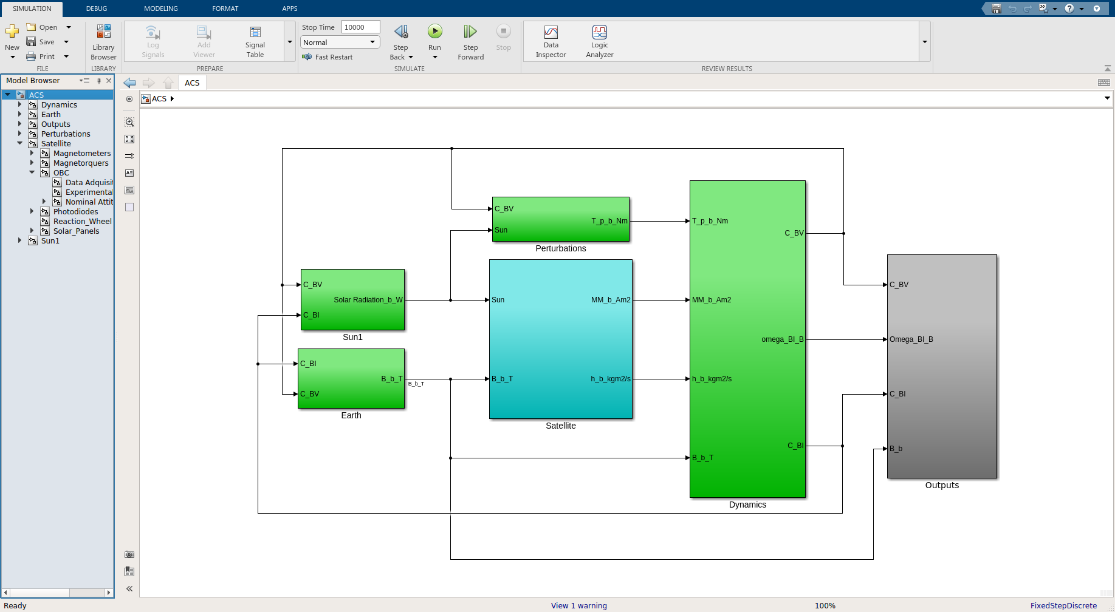
Simulink model
Run matlab and open ACS.slx from directory LAB7/ACS.

Slide 37
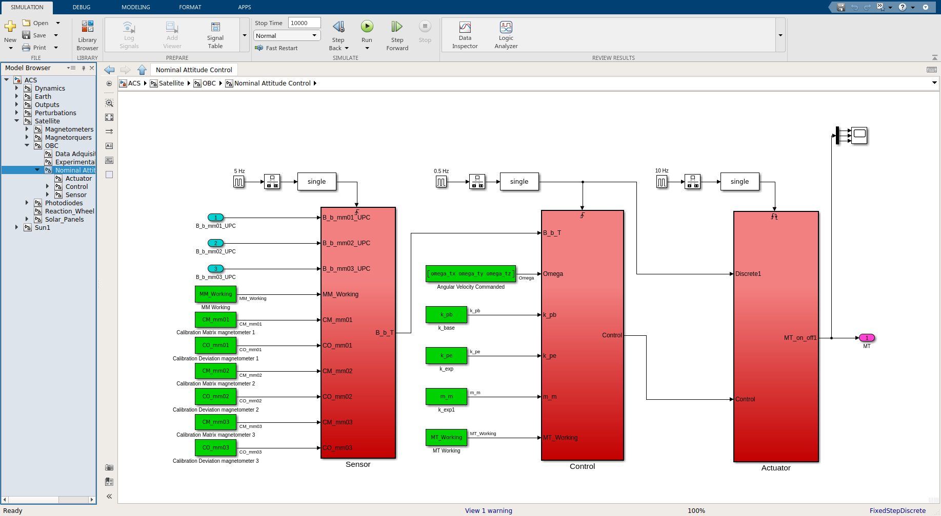
Simulink model
Navigate to nominal attitude control.
Simulate and verify angular velocity stabilization

Slide 38
Validation steps: Processor-in-the-loop
A further step to full validation is running the control software on actual hardware, while still using simulation models of the sensors, actuators, and spacecraft dynamics.
A software validation facility (SVF) uses an auxiliary computer, linked to the OBC by a serial line, to run a simulation model of the Earth's magnetic field and the satellite dynamics.
In this way, engineering values (Nm and T) can be interchanged.
The code of the control algorithm is generated with the Simulink Code Generator, and compiled and linked with the on-board software using the GNAT development environment.
Functional & real-time behaviour can be validated.
Notes:
PIL TRL 4

Slide 39
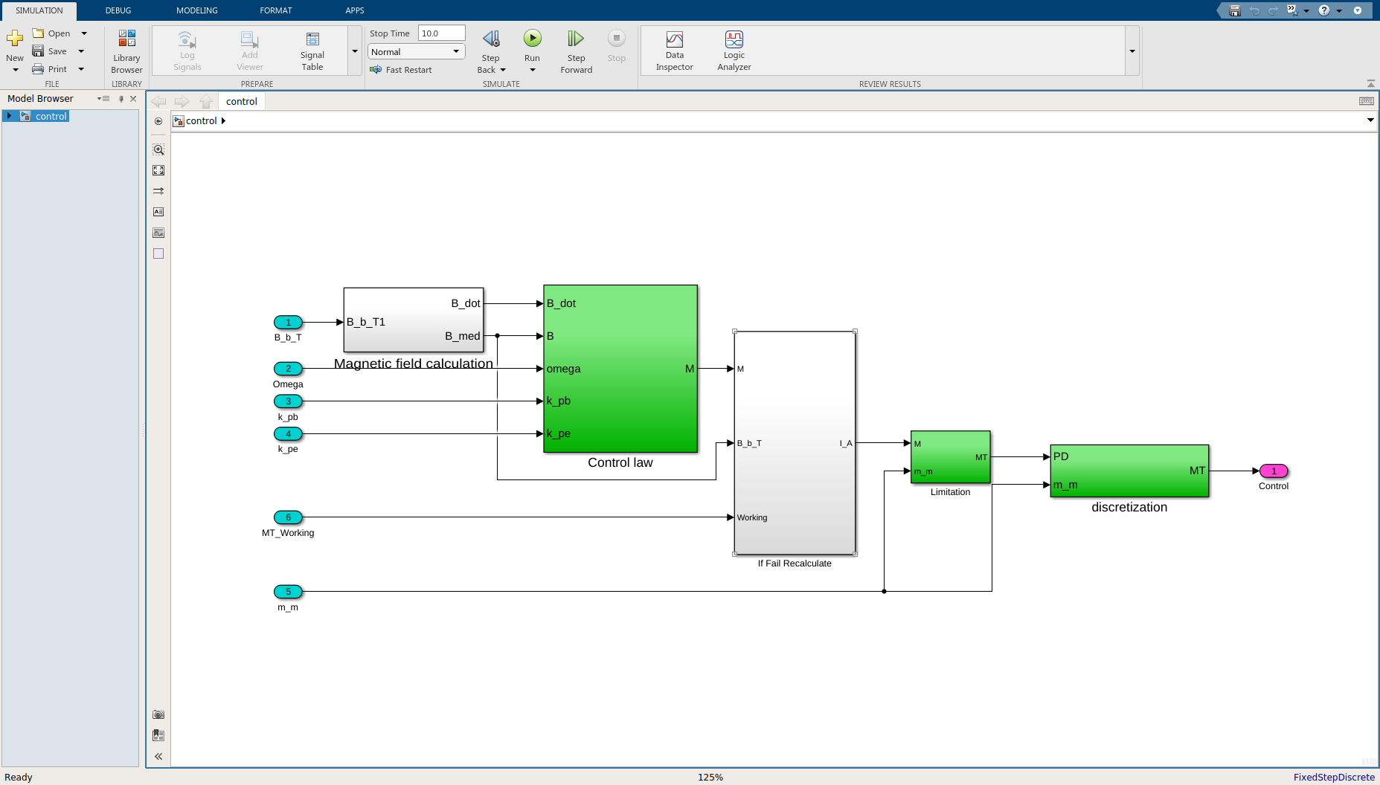
Simulink model for code generation
Open control.slx from directory LAB7/ACS_PIL
Select APPS and then Embedded Coder

Slide 40
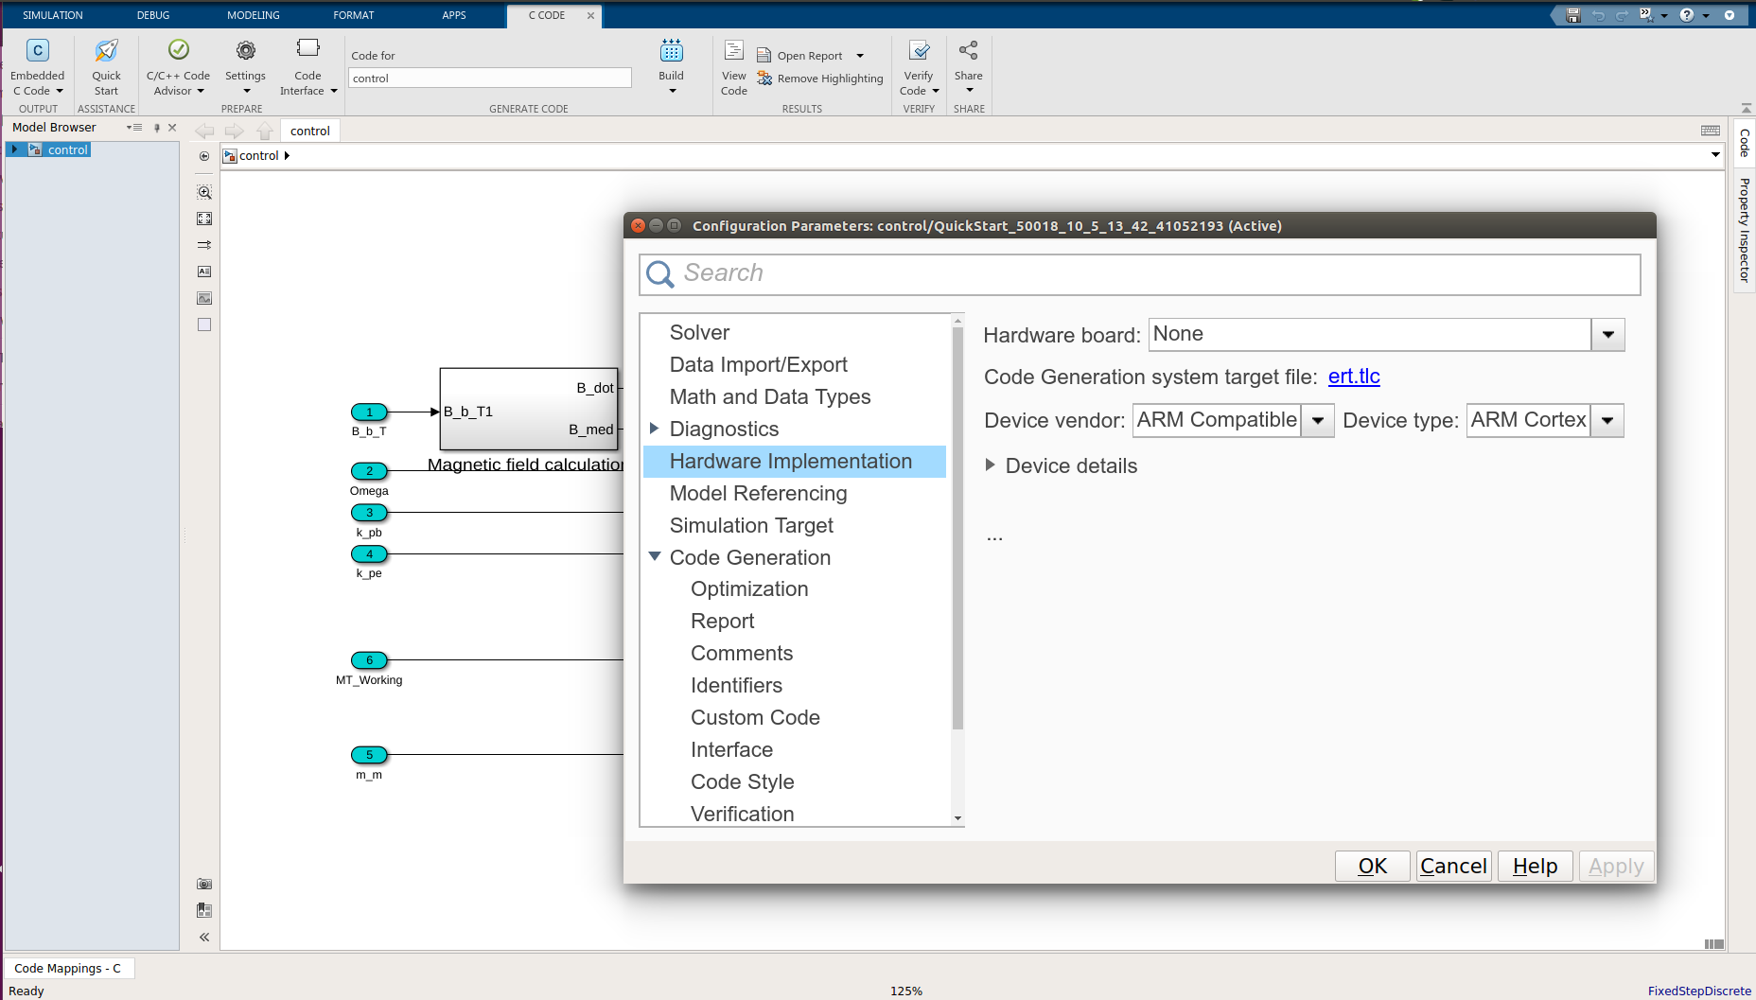
Code generation
Take a look to Code generation settings (Settings button)
Generate code with Embedded Coder toolbox (Build button)
Take a look to code generation report (it will pop-up)

Slide 41
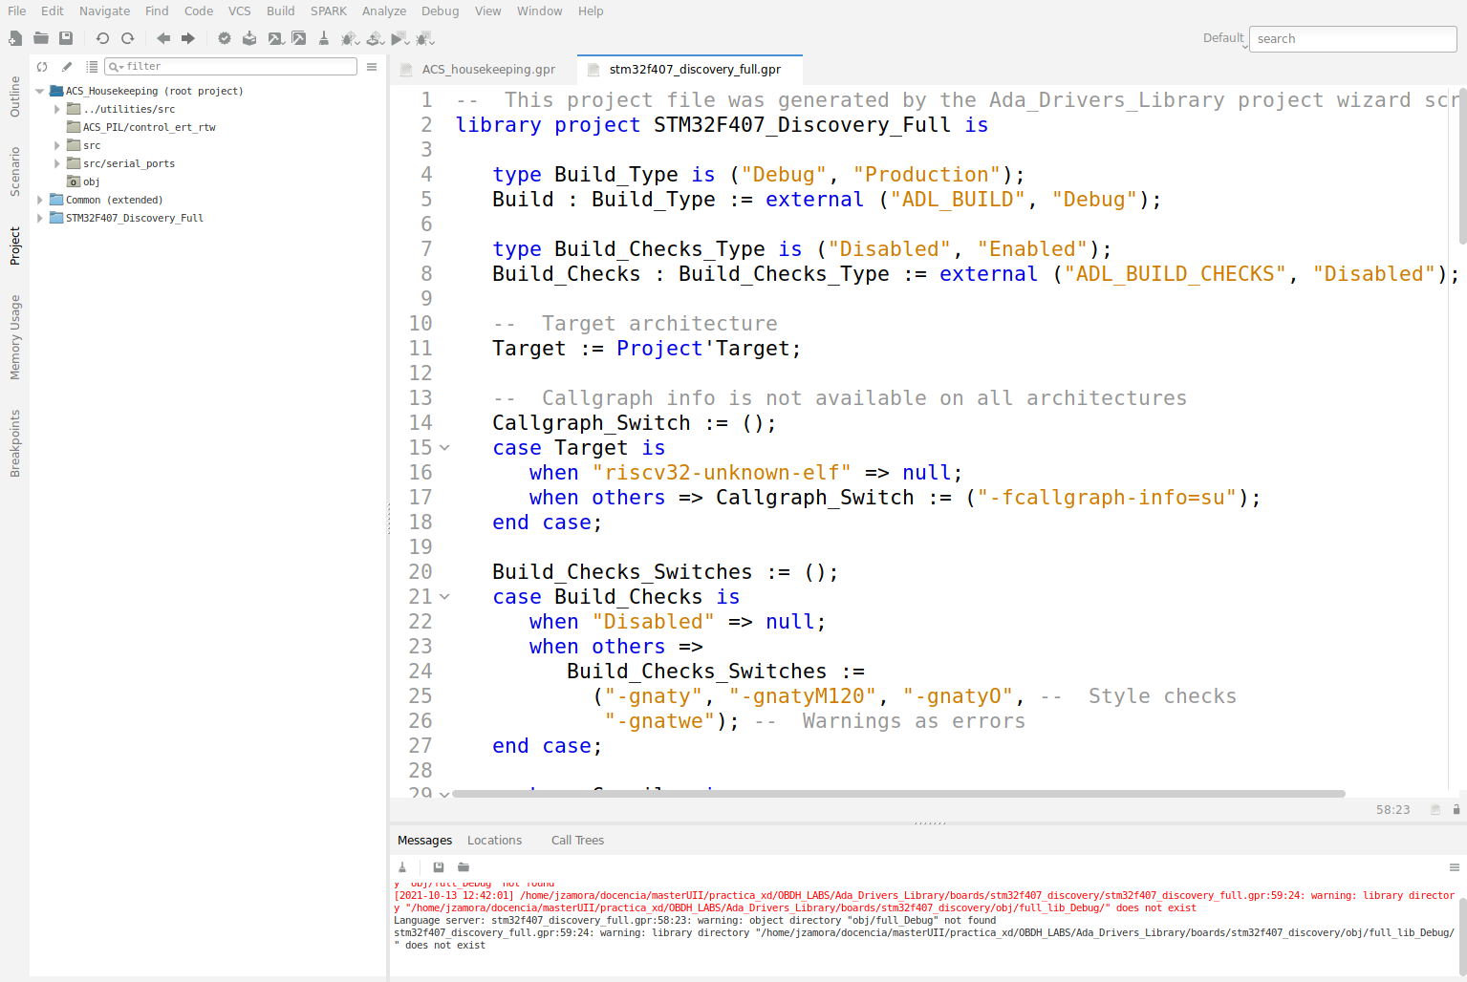
Code generation
The generated C code is located at LAB7/ACS_PIL/control_ert_rtw
Launch gnatstudio and open LAB7/ACS_housekeeping.gpr

Slide 42
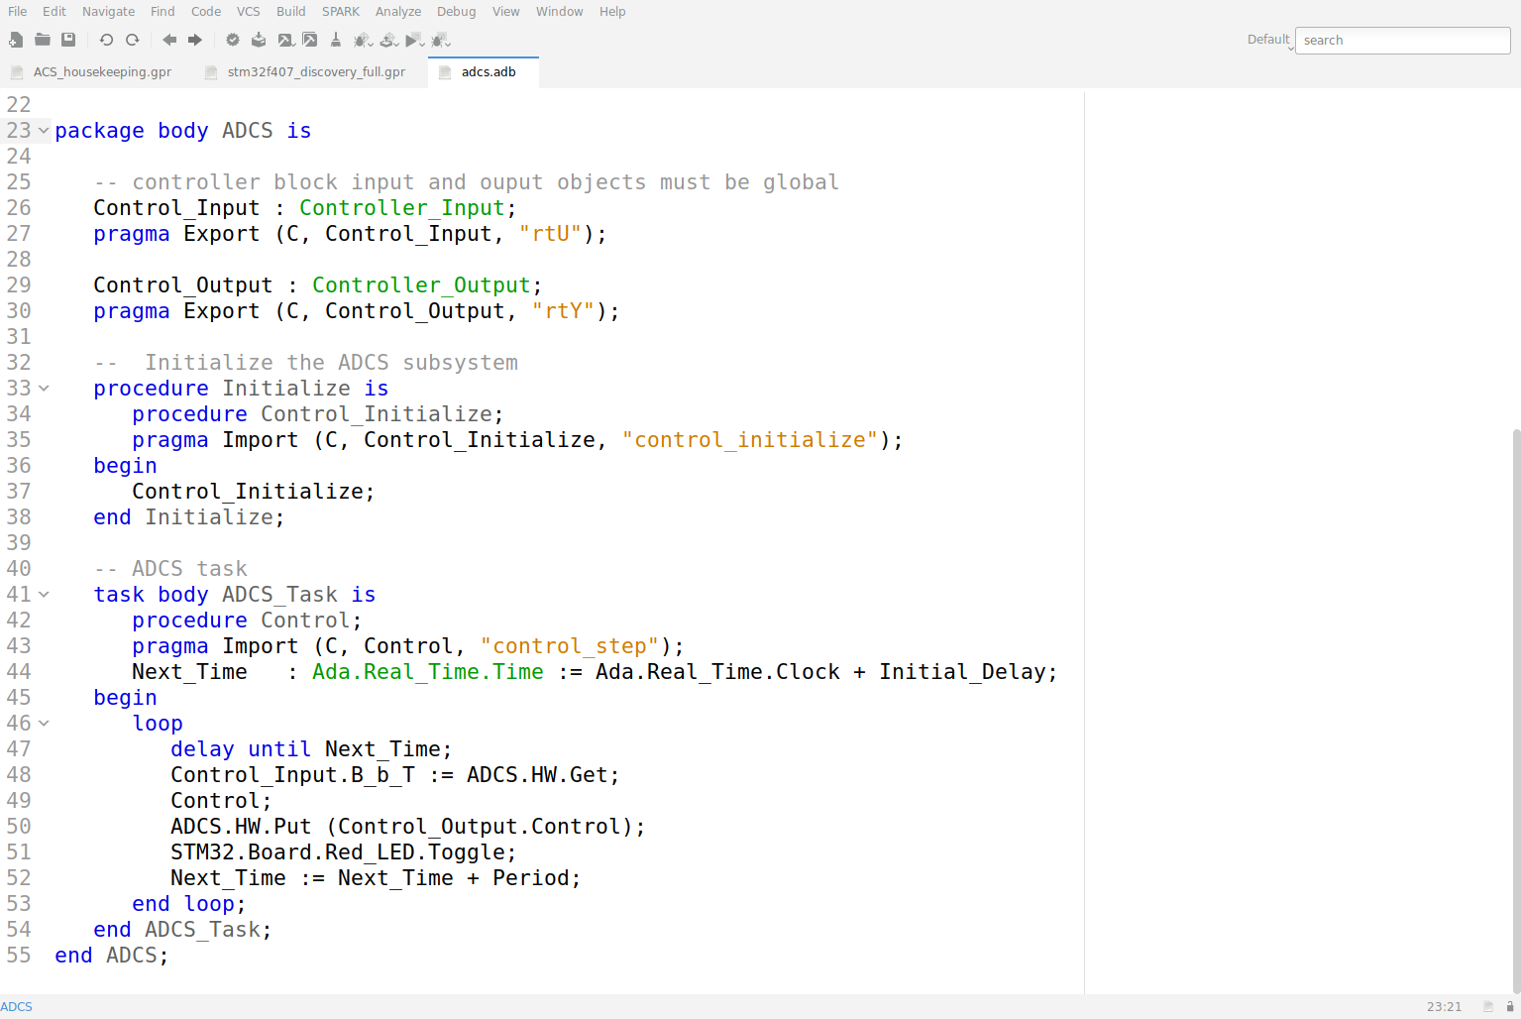
ACS implementation

Slide 43
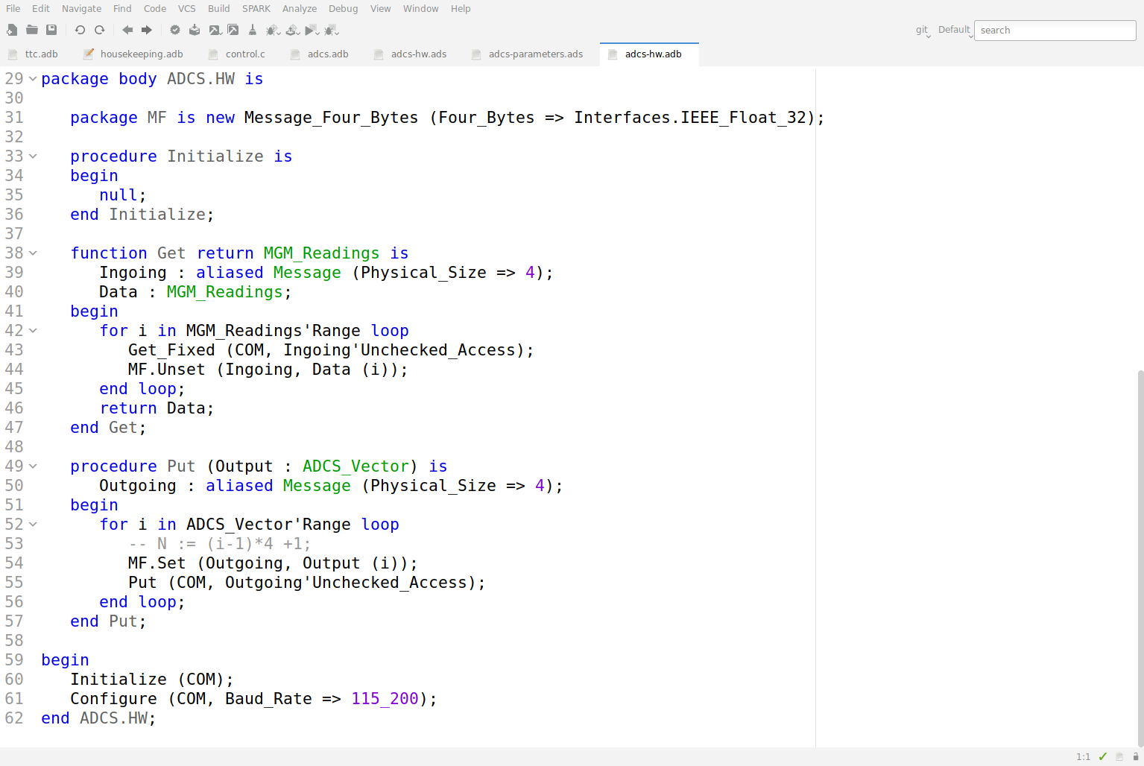
ACS Hardware interface

Slide 44
Study the code
Connect the serial line to the host PC
as in LAB5 but do not run PutTTY
serial line will be used for interchanging sensor readings and actuations
Build the executable and debug on the board
select Build > Bareboard > Debug on board on the top menu
Type continue or just c on the debugger console
The program starts
The Red LED does not blink because ACS is waiting sensor inputs from SVF.
Laboratory

Slide 45
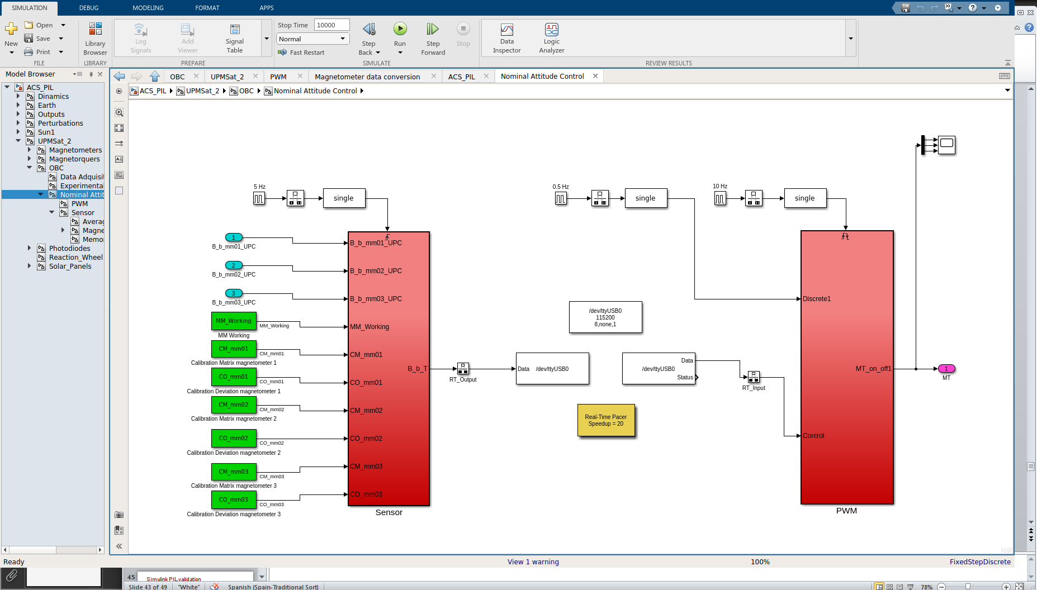
Simulink model por PIL validation
Open ACS_PIL.slx from LAB7/ACS_PIL directory
Navigate to nominal attitude control.

Slide 46
Study the model
The control block has been replaced by a connection to the serial line
edit the serial configuration block and put the name of the serial line of your PC
additional rate transition blocks have been added to ensure a proper communication
A Real-Time pacer has been added to the model to set the simulation speed
Speedup = 1 should be used but it is too slow
Start the simulation and verify angular velocity stabilization
Now ACS runs and red LED is toggled
Laboratory

Slide 47
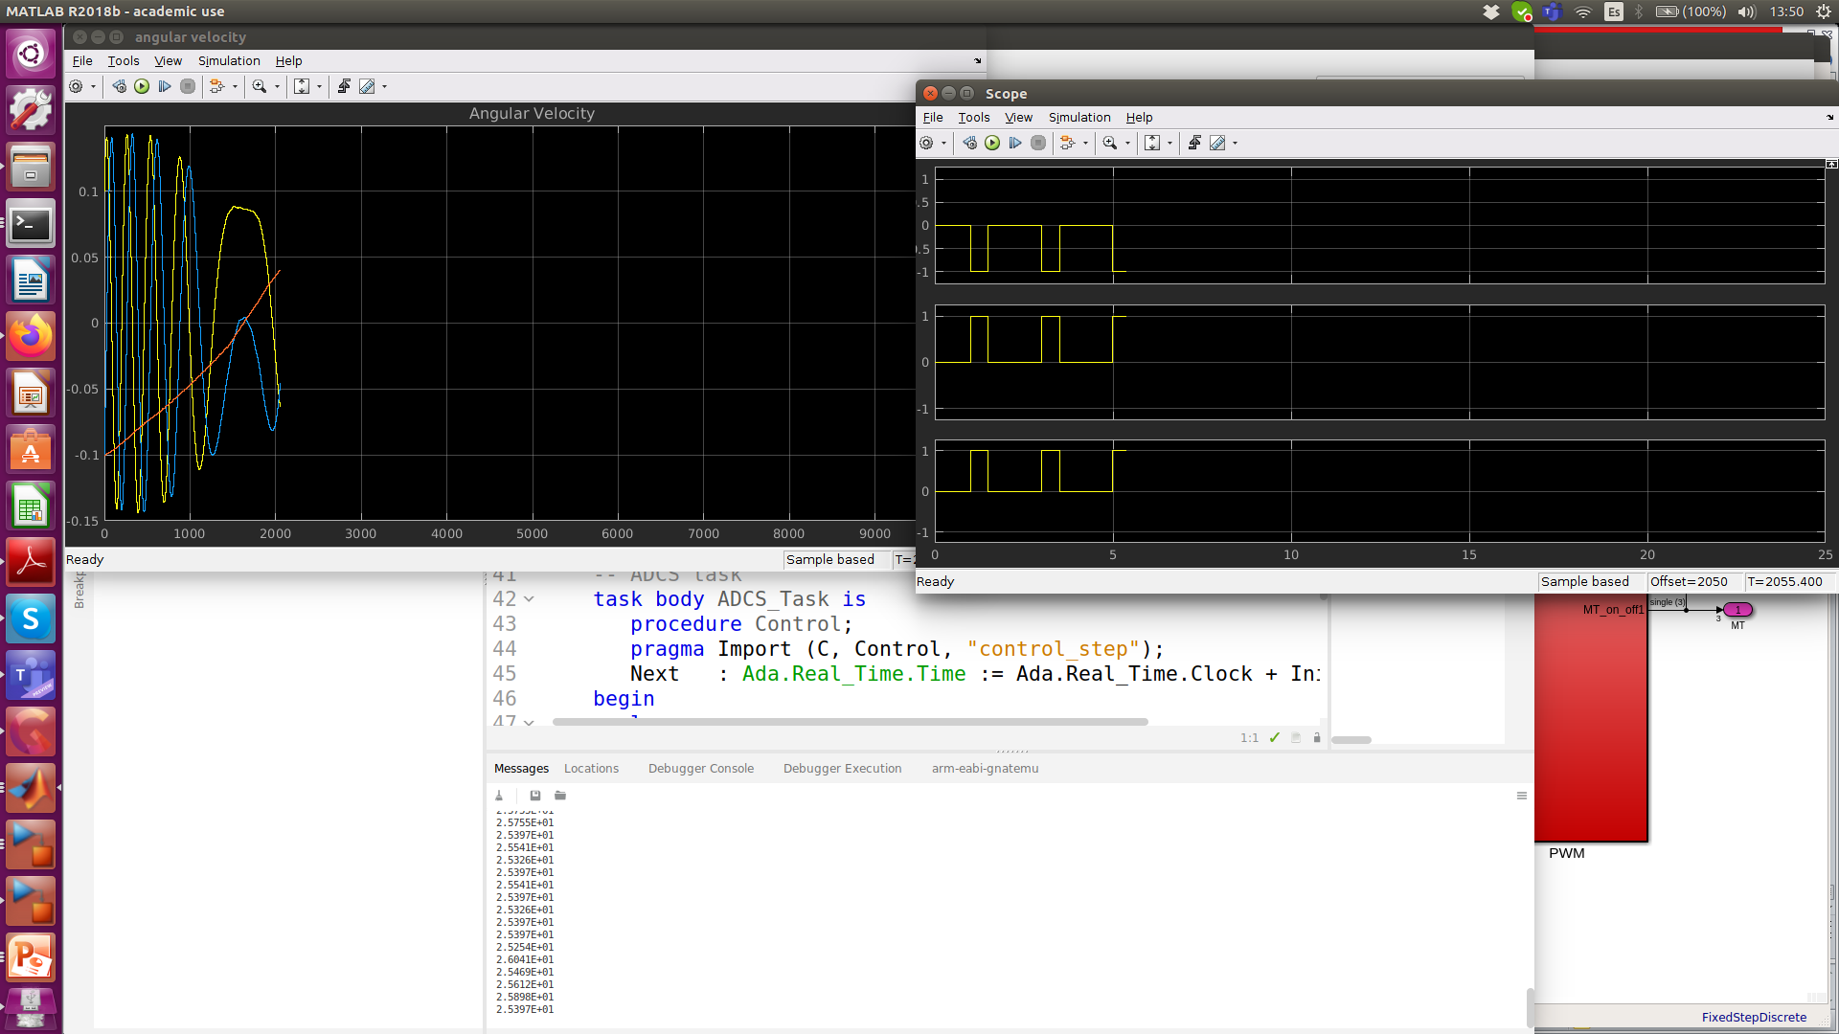
Simulink PIL validation
Compare angular velocity stabilization with the original full-Simulink model.

Slide 48
Make changes and play
Default parameters for control blocks can be changed in Ada source file ACS-parameters.ads
Default_omega is the consigned angular velocity
Default_MT_Working contains the operational magneto-torques
In UPMSat-2 the parameters can be changed by TC
The initial angular velocity can be changed in Simulink source code initialization.m
omega_BI_B0 = [0.1;-0.1;-0.1];
Laboratory

Slide 49
Validation steps: Hardware-in-the-loop
The next step is to include a model of the actual magnetometers and magnetorquers in the simulation model, and connect their inputs and outputs to the OBC hardware by means of its analog and digital input and output lines.
This simple kind of HIL setup allows the operation of input/output devices, as well as signal conditioning hardware and software, to be validated.
Full HIL validation, though, requires using the real magnetometers and magnetorquers hardware and, ultimately, the whole satellite structure, on a setup which enables the attitude of the spacecraft to evolve in a free fashion.
Notes:
PIL TRL 4

Slide 50
Technology Readiness Level (TRL)
The technical maturity of instruments and spacecraft sub-systems with respect to a specific space application are classified according to a "Technology Readiness Level" (TRL) on a scale of 1 to 9. ESA uses the ISO standard 16290 Space systems – Definition of the Technology Readiness Levels (TRLs) and their criteria assessment.
ISO Technology Readiness Level Summary
TRL Level Description
1 Basic principles observed and reported
2 Technology concept and/or application formulated
3 Analytical and experimental critical function and/or characteristic proof-of-concept
4 Component and/or breadboard functional verification in laboratory environment
5 Component and/or breadboard critical function verification in relevant environment
6 Model demonstrating the critical functions of the element in a relevant environment
7 Model demonstrating the element performance for the operational environment
8 Actual system completed and accepted for flight ("flight qualified")
9 Actual system "flight proven" through successful mission operations
http://sci.esa.int/sci-ft/50124-technology-readiness-level

Slide 51
Hardware In the Loop
To reach a higher TRL, a more realistic operational environment is needed
In UPMSat-2, ADC hardware was also included in the loop
A SVF host with analog input/outputs had to be set up in order to generate magnetometer outputs and read magnetorquer actuations.
Much more sophisticated operational environments are possible.
However, they have a high cost
Laboratory

Slide 52
Hardware In the Loop
To reach a higher TRL, a more realistic operational environment is needed
In UPMSat-2, ADC hardware was also included in the loop
A SVF host with analog input/outputs had to be set up in order to generate magnetometer outputs and read magnetorquer actuations.
Much more sophisticated operational environments are possible.
However, they have a high cost
Laboratory

Slide 53
Student assignment
Students have to write a brief report of about 2-3 pages about the work done including an analysis about cross-development environment for embedded systems and the main differences with a native environment.
The schedulabilty analysis for LAB6 must be included.
The report can contain recommendations to improve the assignment and personal opinions.
If you have made the proposed changes or any other, you should write them in the report and upload the code too.
Moodle is the selected platform for uploading assignment and the deadline is December 10th.
Laboratory

